Slide 1
HerbalCare Shopping Website

Slide 2
Group Members:-
Mayur Patil- 41279
Jayesh Sonawane- 42192
Bhushan Patil- 41688
Project Guide:-
Dr. Shilpa Dange

Slide 3


Slide 4
Problem Definition:-
The pandemic is currently engulfing the world. All transactions has stalled. We have faced such situations in the Past too. But there is a difference between the two situations. This time every thing was working smoothly Because of this digital era. Especially medical works. But as we went through this crisis, we observed that Indian Ayurveda played huge role fighting against this situation. During this period, Ayurveda played an important role in boosting the immune system of every individual. But there was always a thing which bothered me greatly. Just as the medicines of allopathy were readily available, at the same time, for the medicines of Ayurveda, everyone had to work hard to find them. And that’s where the idea of HerbalCare ( an e-commerce shopping website exclusively for Ayurvedic Products) came from.

Slide 5
Need For Computerized System:-
In this modern world of Internet, where everything thing is being done in online mode, online shopping is no exception. Nowadays, we all buy variety of things online because there are two reasons, first, they are easily available and second, the products are home delivered which played a very important role in this pandemic situation. These online shopping websites promote and make available all the day to day products easily but they don’t promote our Indian Ayurveda greatly and the herbal medicines are also rarely available on these sites. Hence, being Computer Science students we wanted to create a platform where Ayurvedic products will be promoted Nationwide. A website where are the herbal medicines, herbal products and necessary information about Ayurveda will be available to all.

Slide 6
Proposed System:-
Herbalcare is a website that is no less than any reputed ecommerce website. Visually, we have made it as attractive as possible as well as it has all kinds of facilities which a standard ecommerce website provides. Thousands of people can register on this website in a very secure way. All your information will be safe. We have categorized all the medicines for the convenience of our customers. There are separate sections for each type of medicine. You will find complete information on each drug on the tab of that drug. In order to get the medicine You want in one place, we have made available the famous facility ‘add to cart’ on this website. There are options to place your order for cash on delivery as well as to make online payment on this website. You can do secure transaction here. We don’t believe only on sales and profits. We care about overall wellbeing of our customers. We all know that the imbalance of ‘Tridosha’ is the root cause of every disease. If we don’t have any idea of our enemy then how would we fight him. Hence we have made available a very innovative quiz which by attempting will tell you your type. And by using Ayurvedic products you can balance these doshas and can attain optimum health in no time.

Slide 7
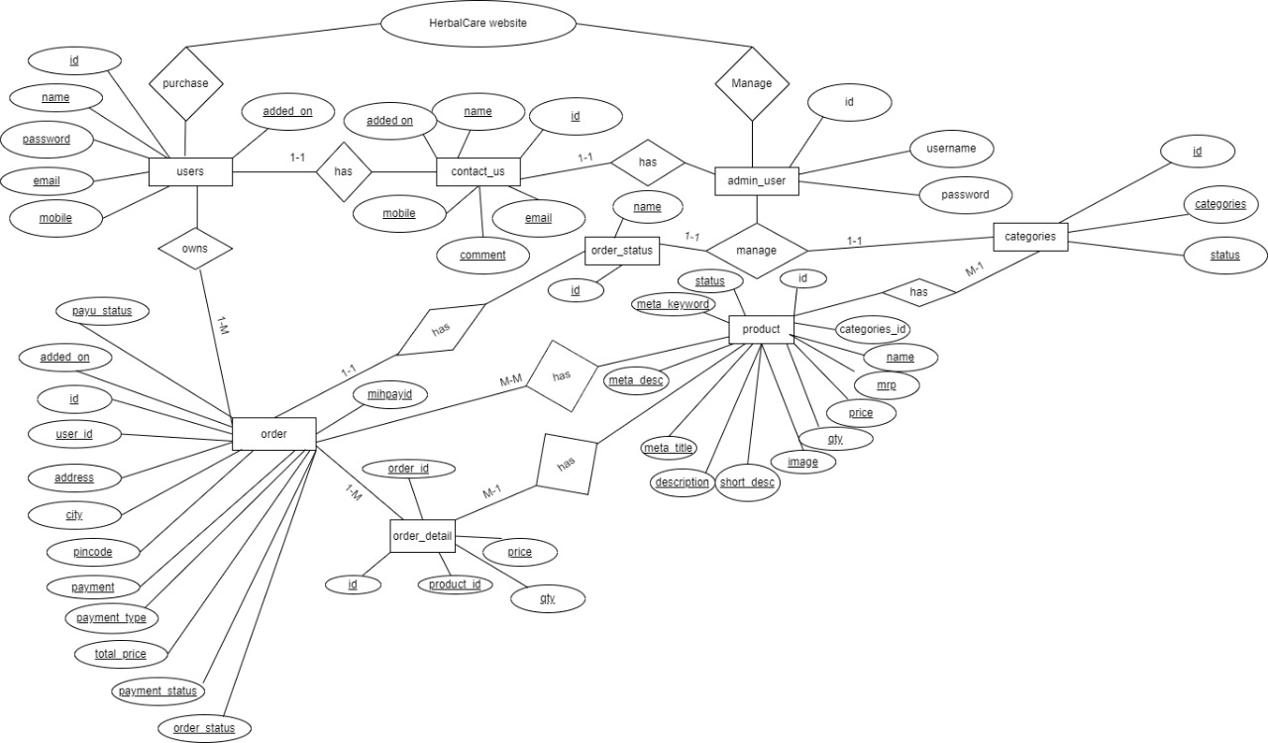
E-R Diagram:-

Slide 8
Data Dictionary

Slide 9
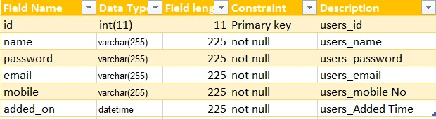
User Table:-

Slide 10
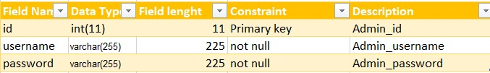
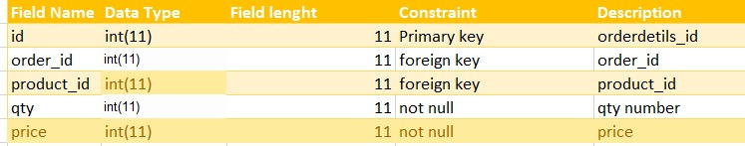
Admin_user Table:-
Order_detail Table

Slide 11
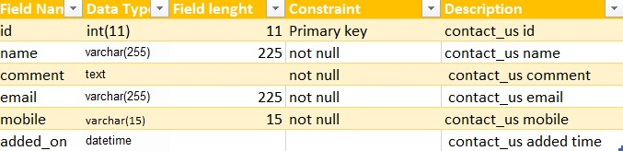

Contact_us Table:-
Order_status Table:-

Slide 12
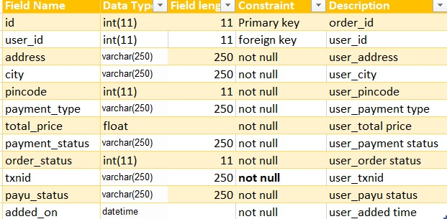
Order Table:-

Slide 13
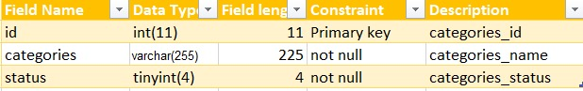
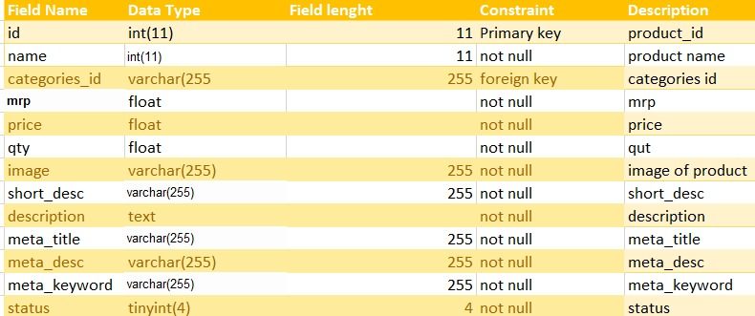
Categories Table:-
Product:-

Slide 14
I/o Screen Design

Slide 15


Welcome Page

Slide 16
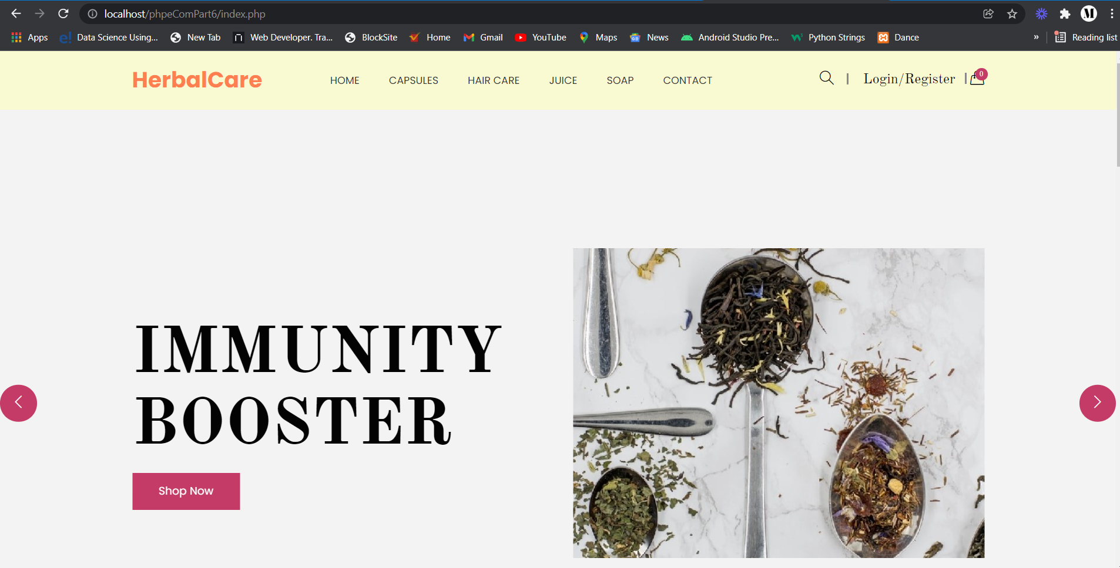
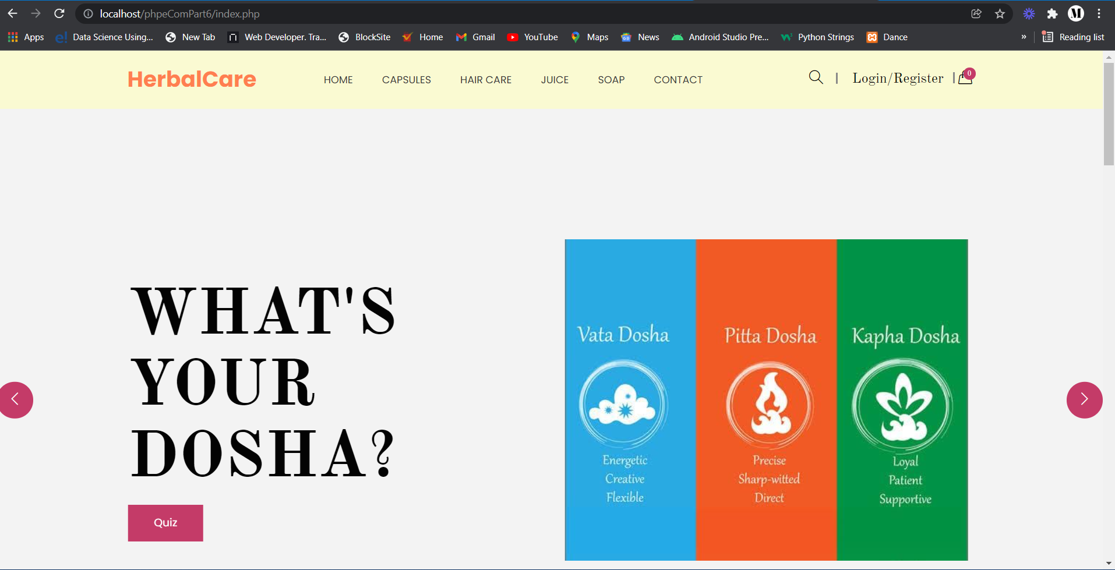
Home Page

Slide 17
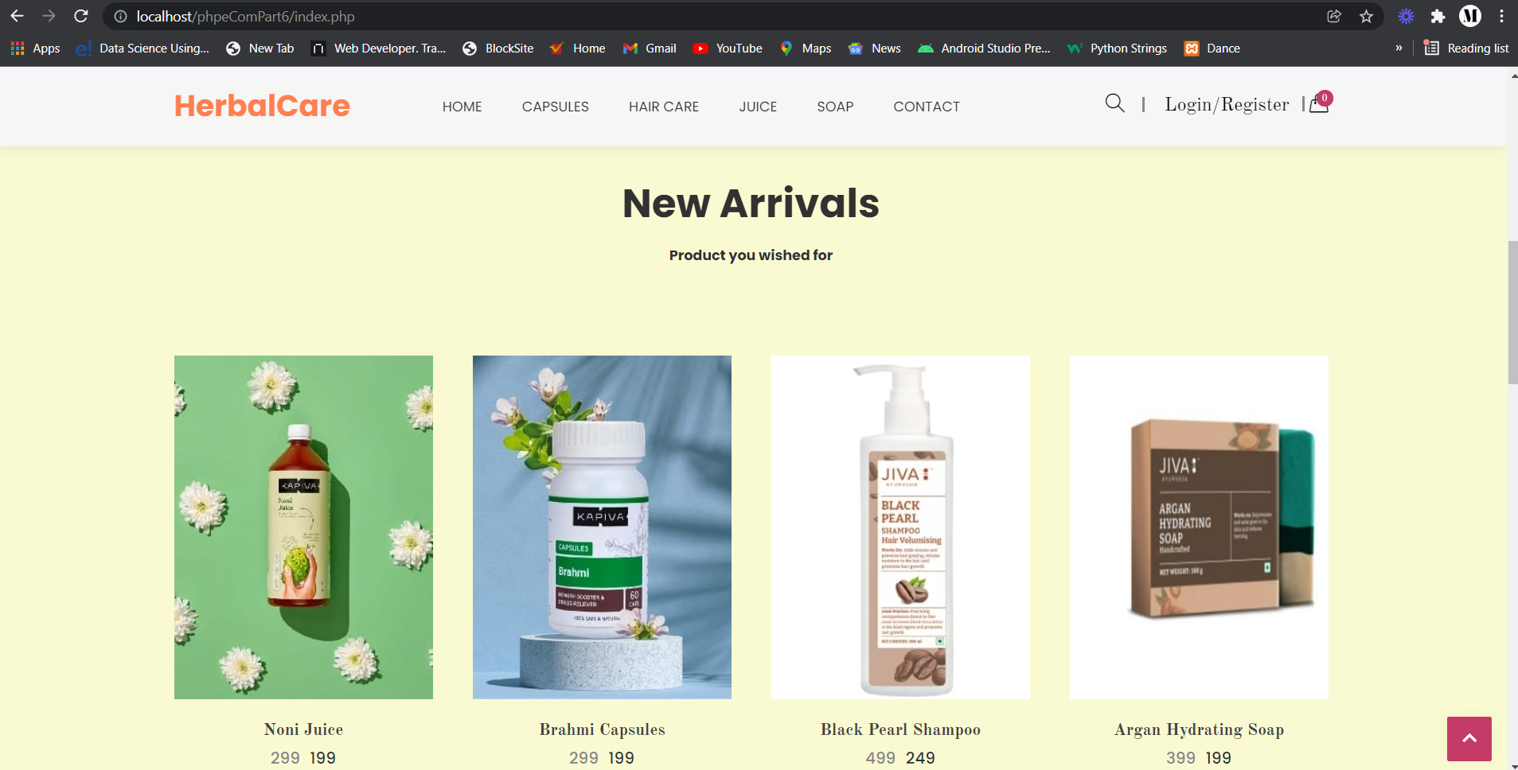
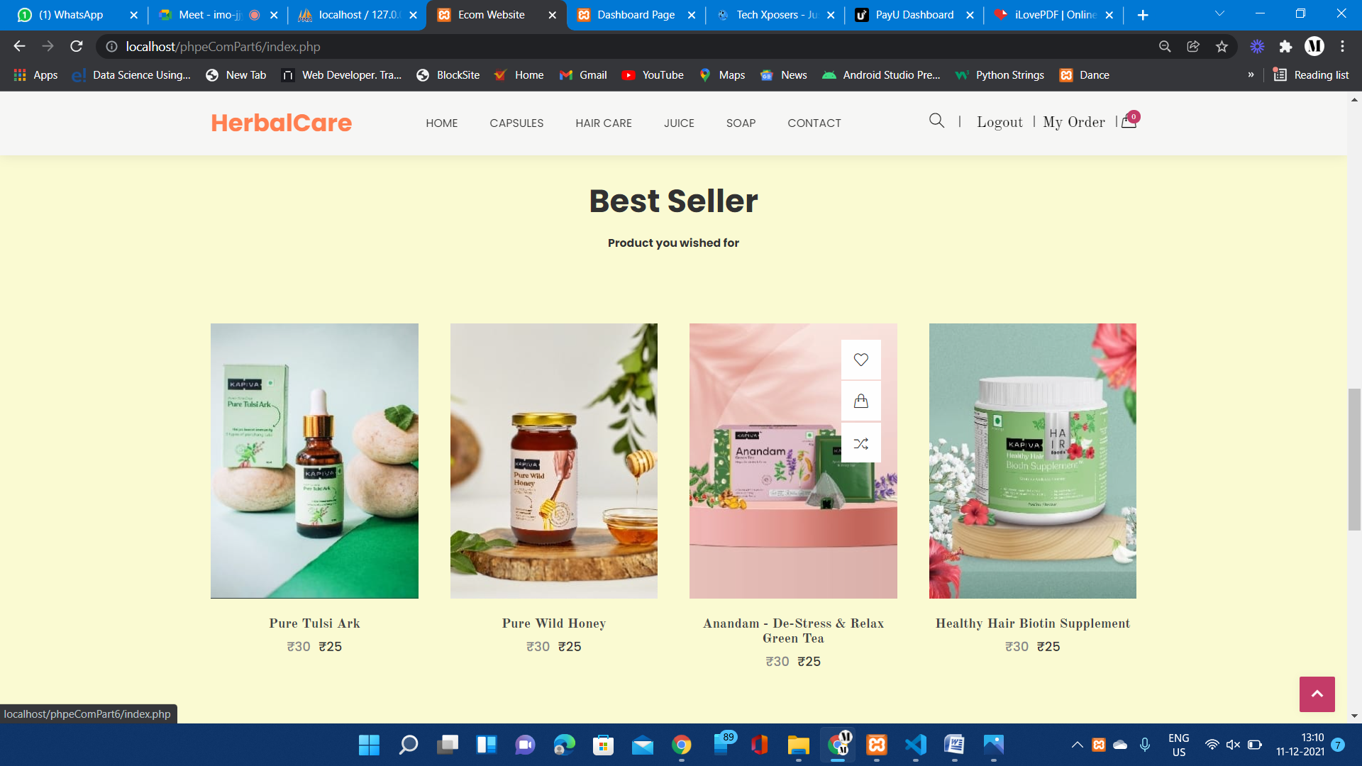
New Arrivals

Slide 18
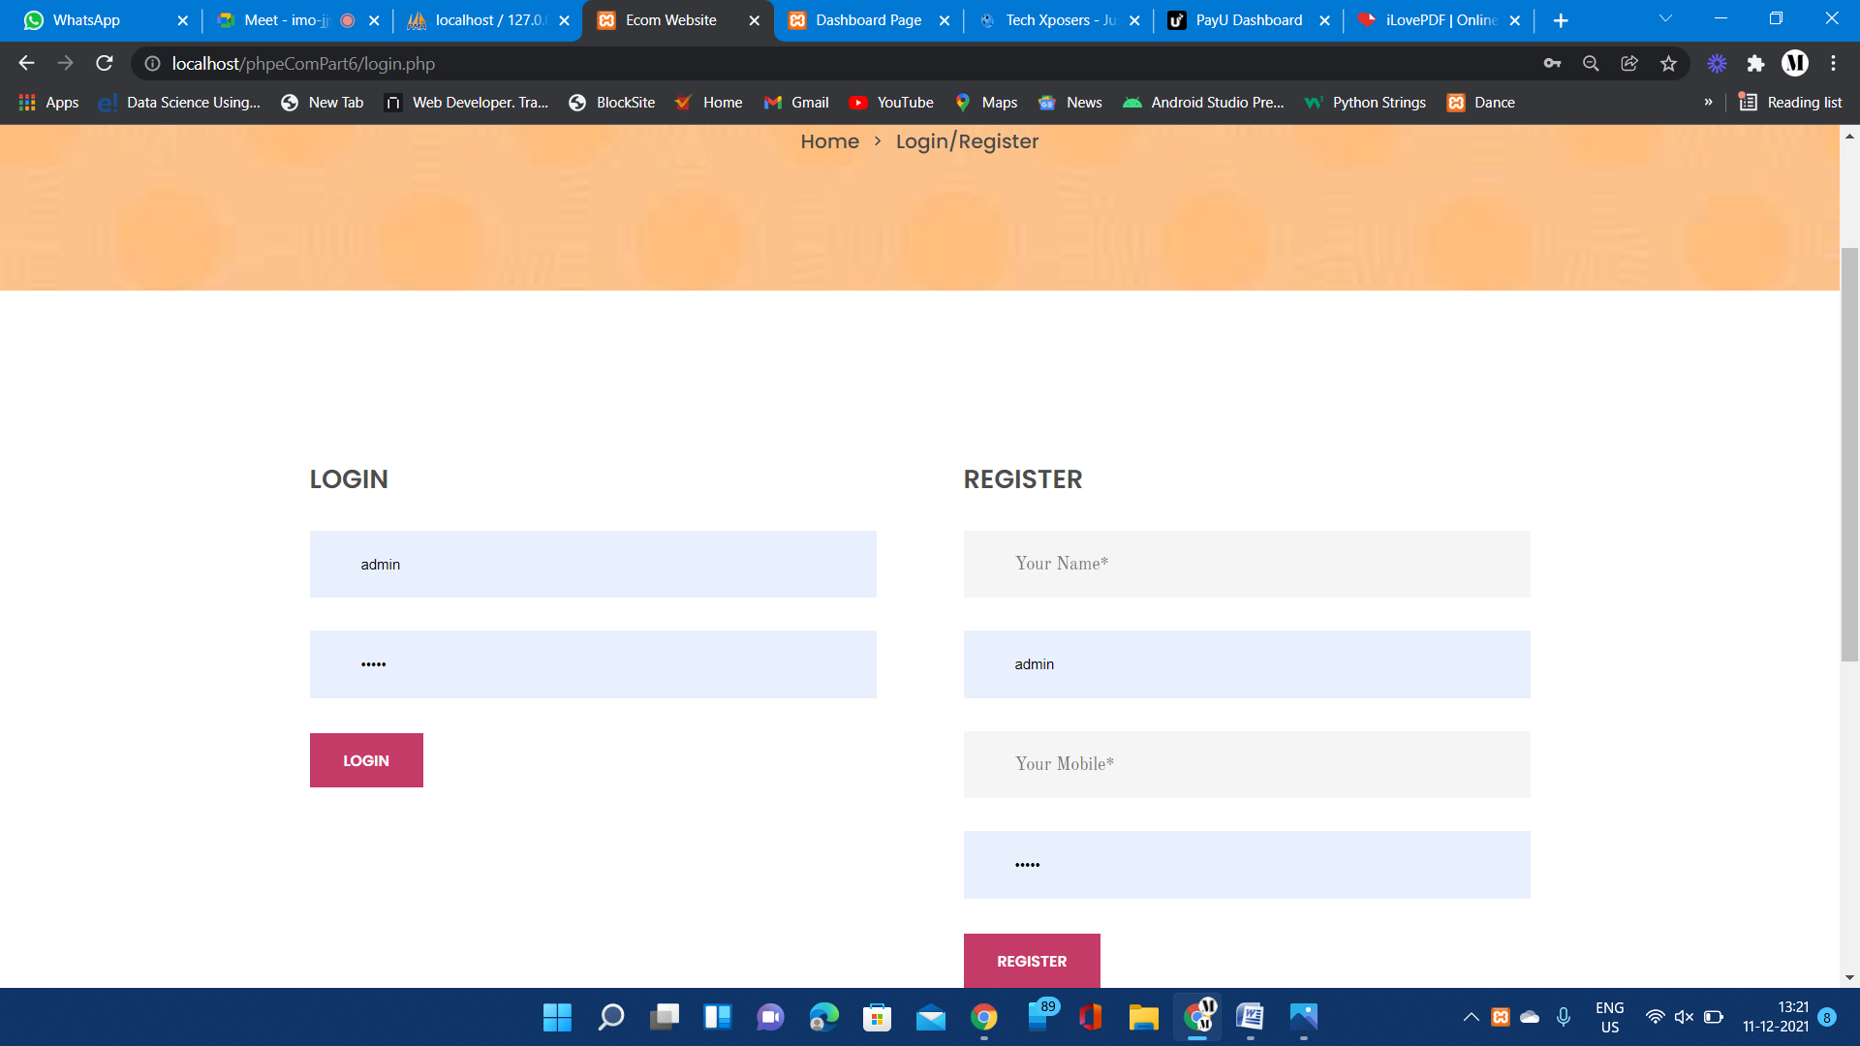
Register/Log In Page

Slide 19
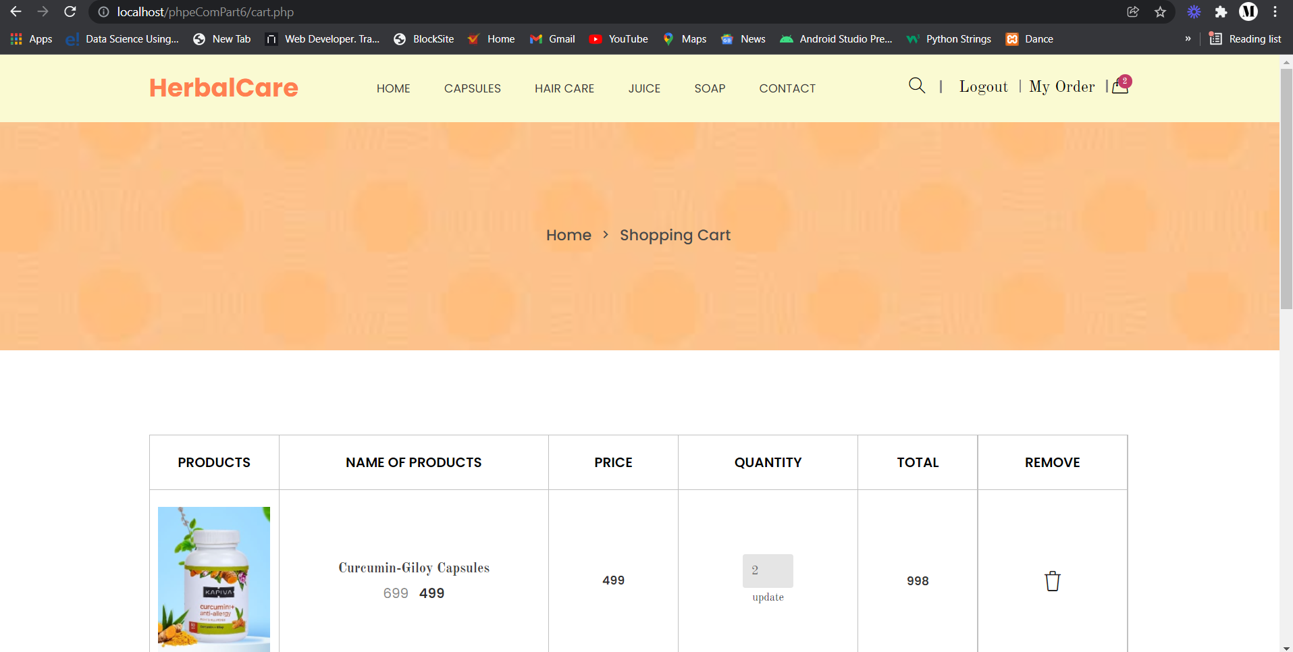
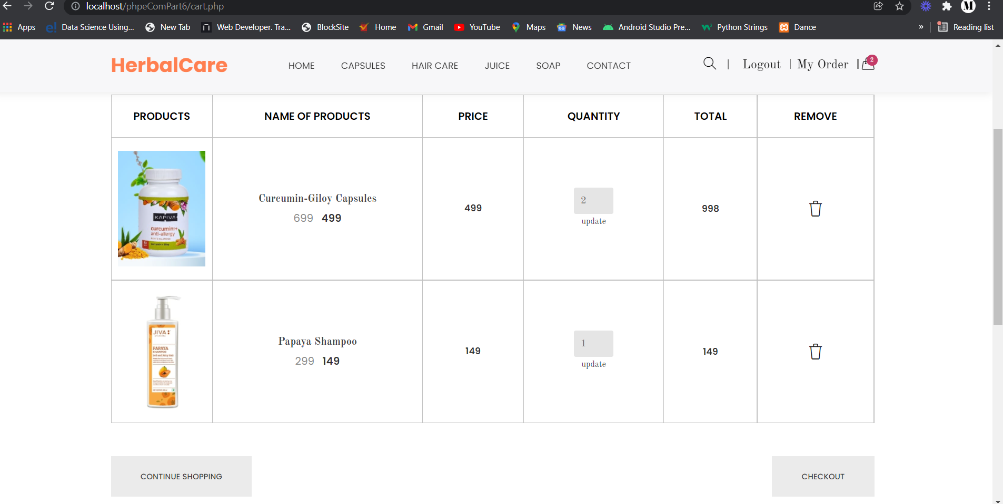
Add To Cart

Slide 20
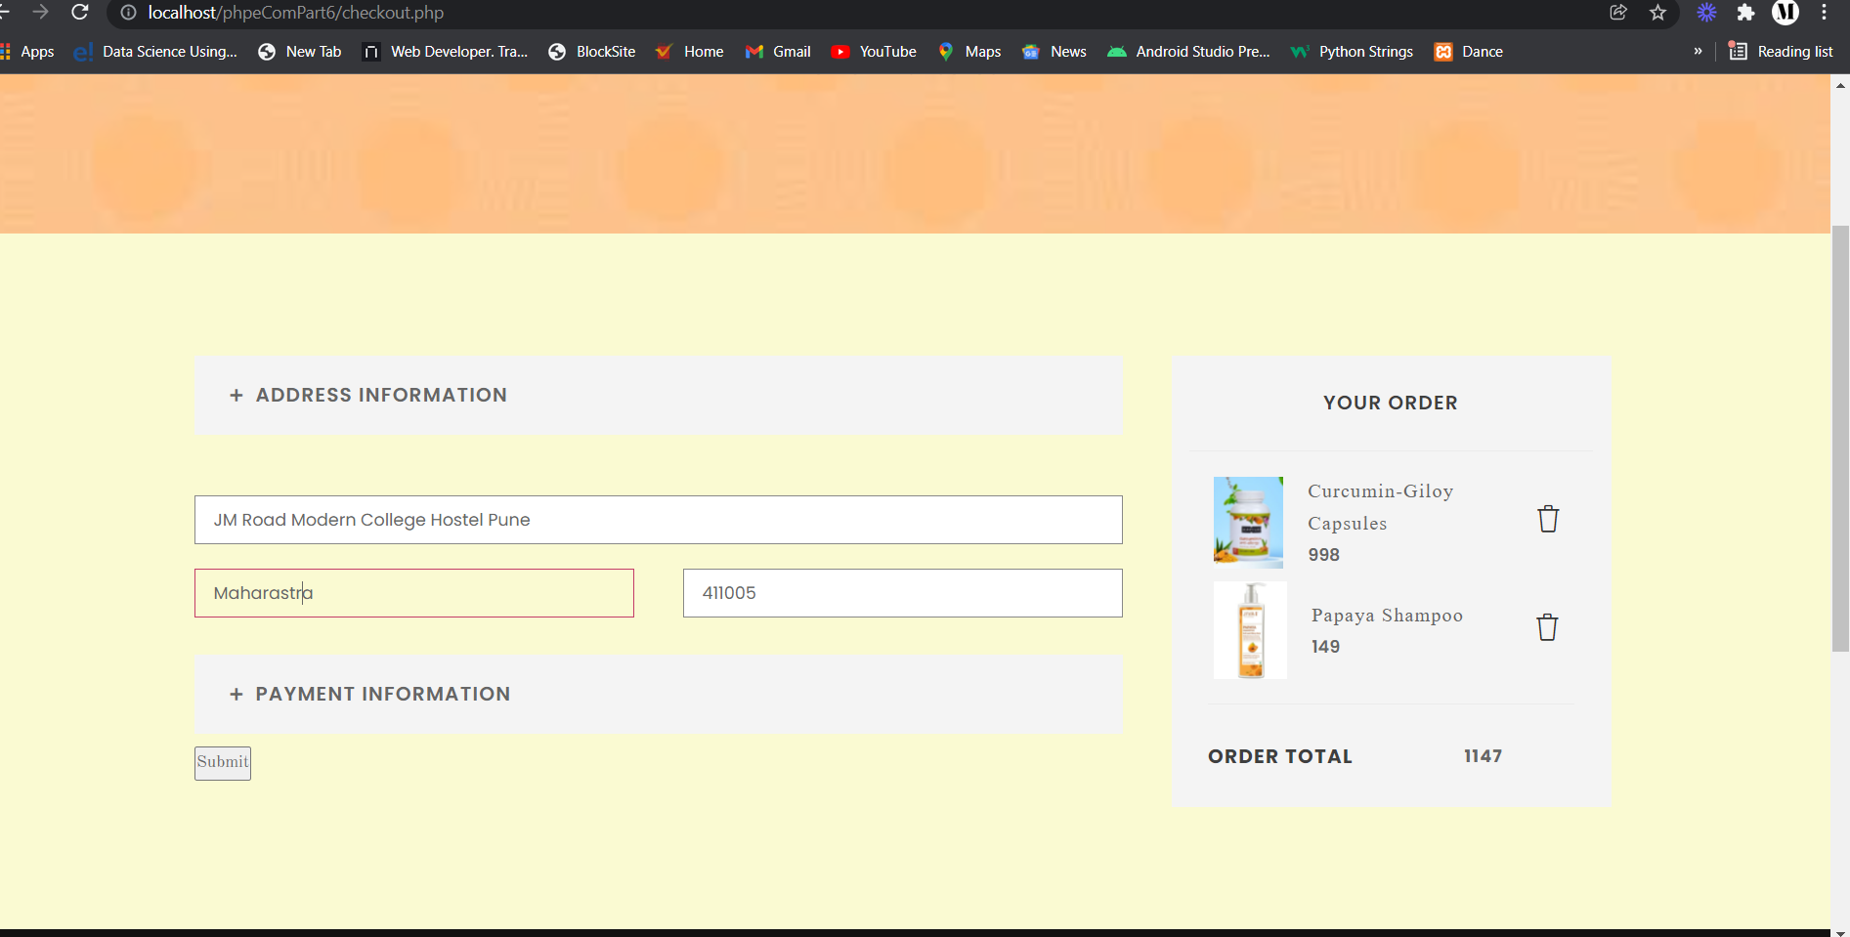
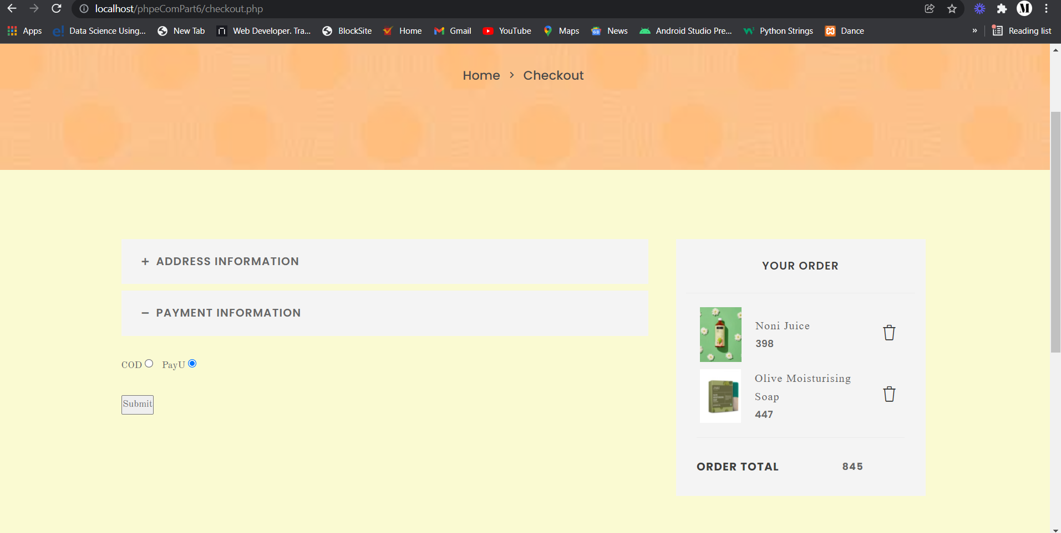
Checkout Page

Slide 21
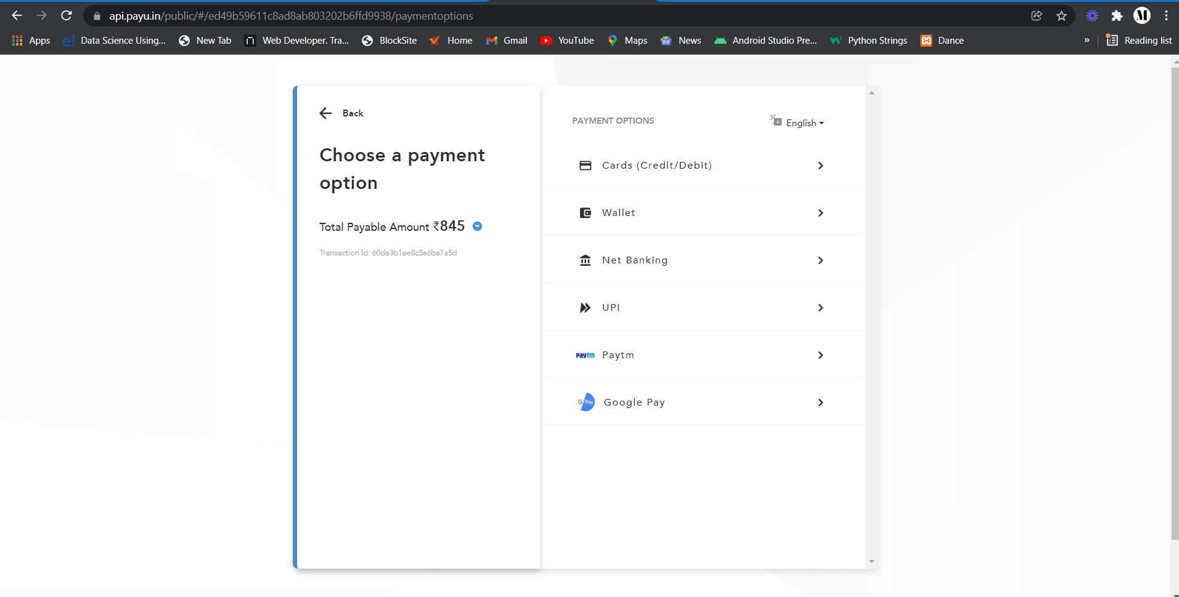
Online Payment Page

Slide 22
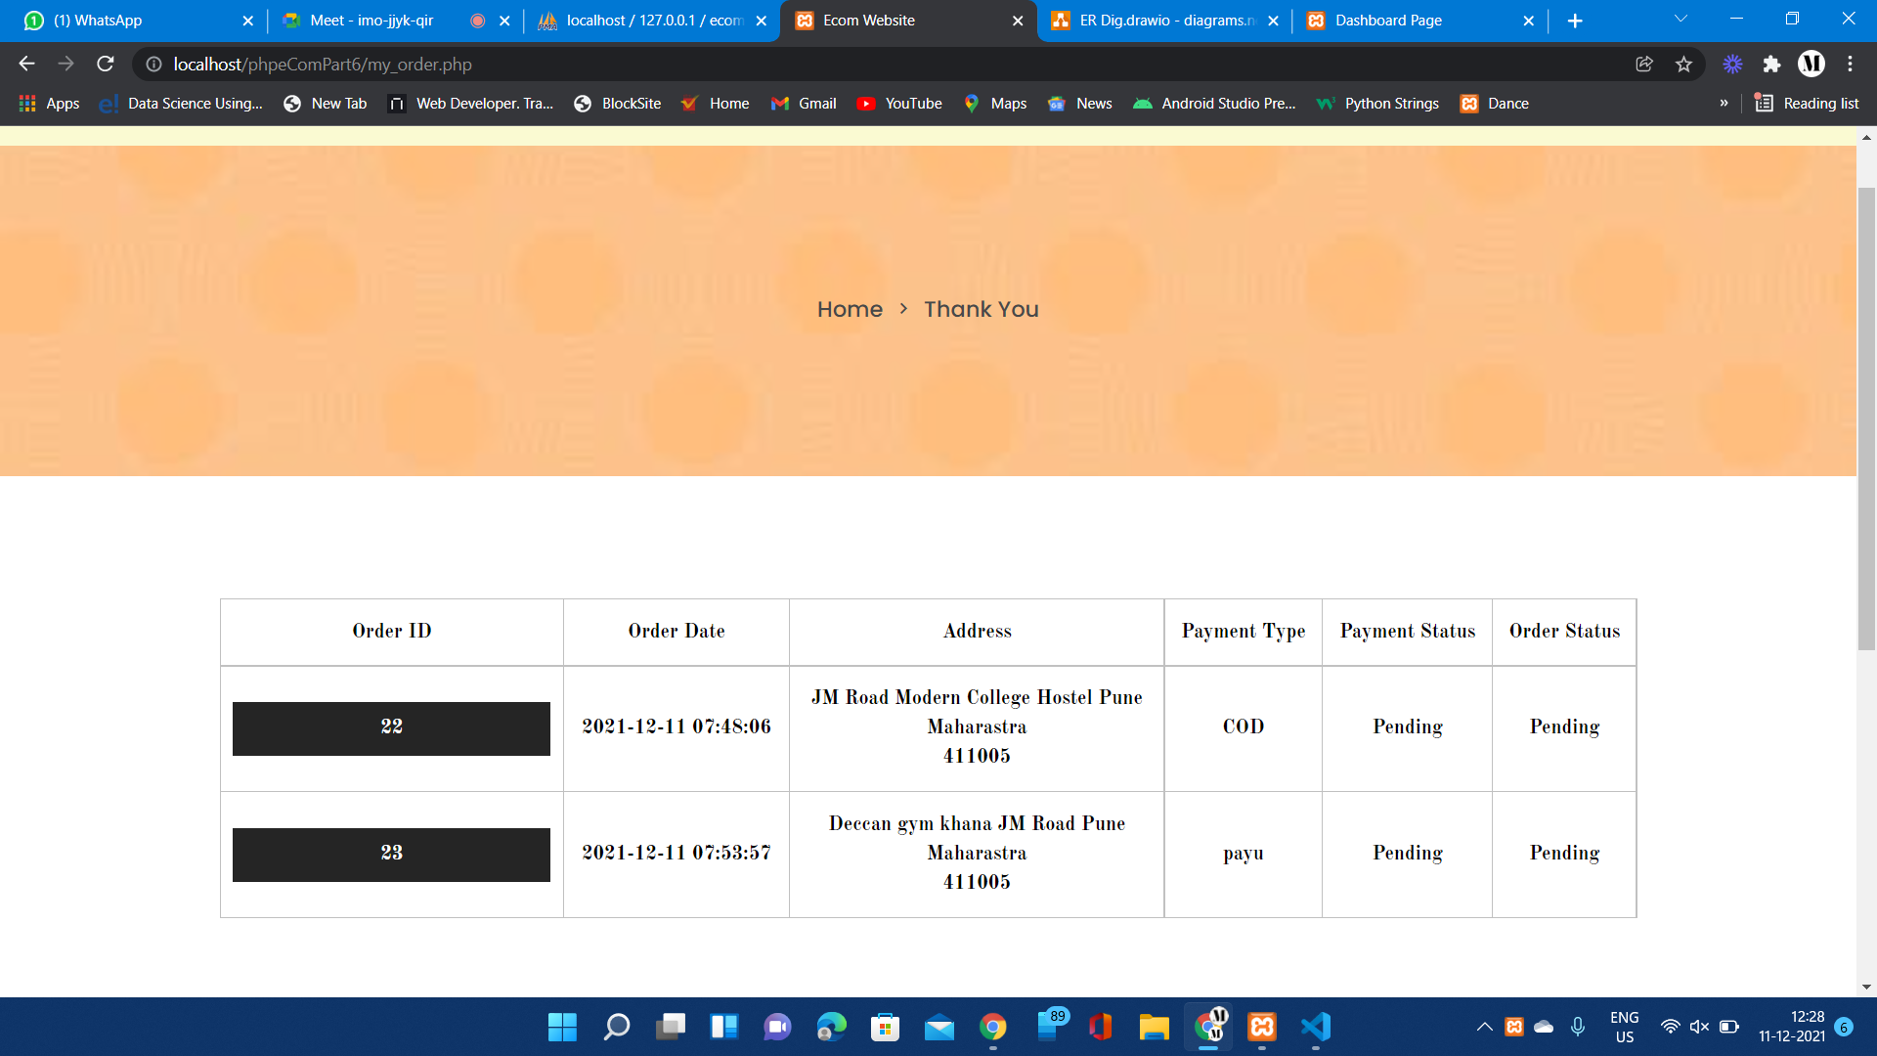
Order Details Page

Slide 23
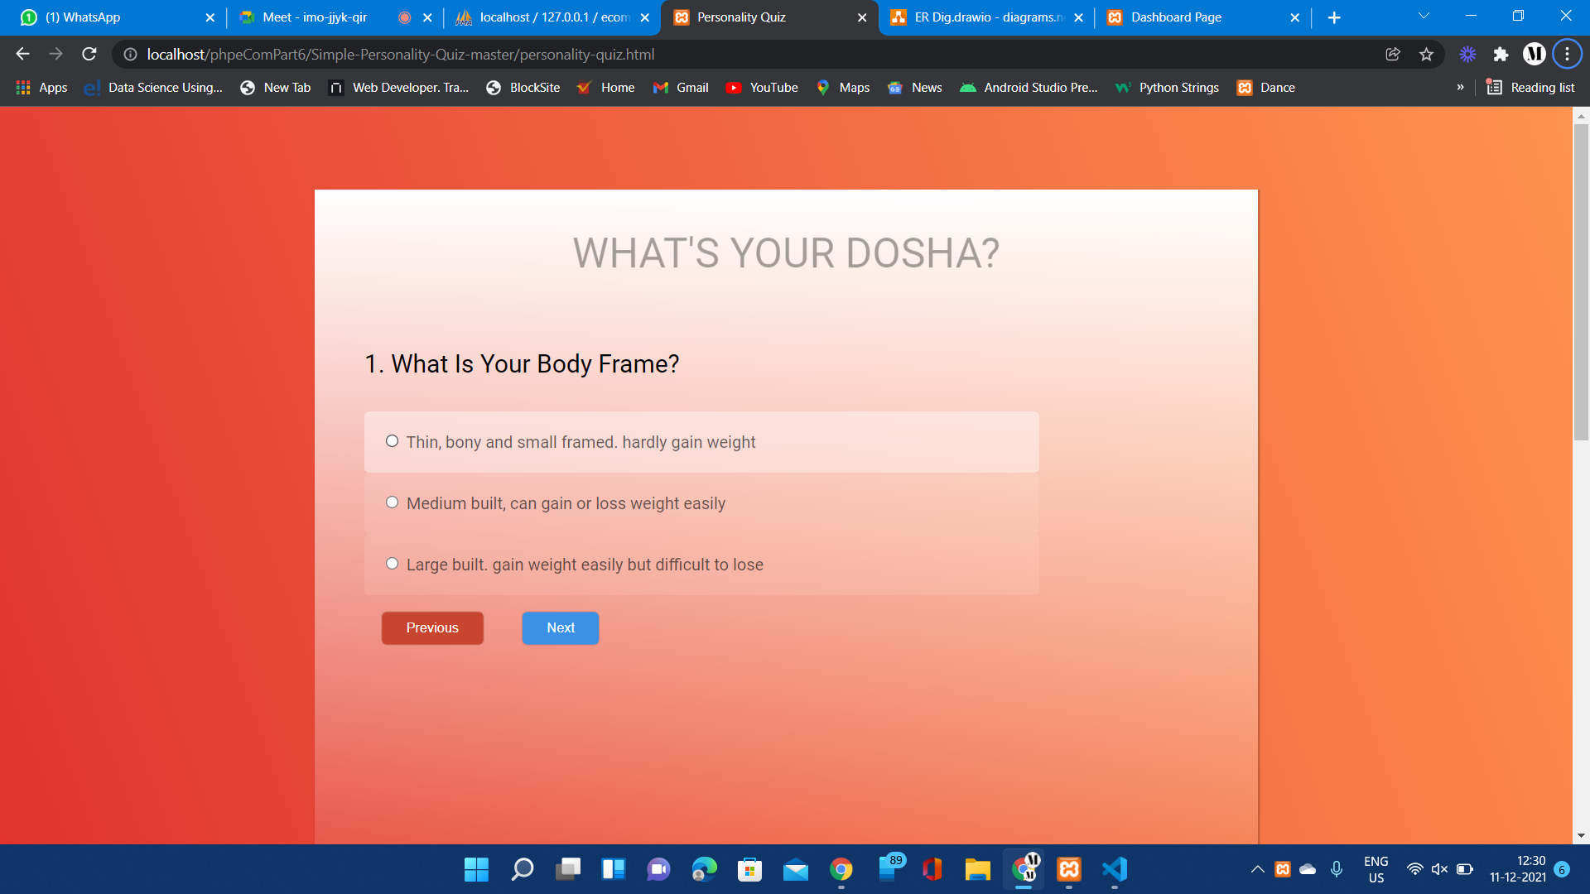
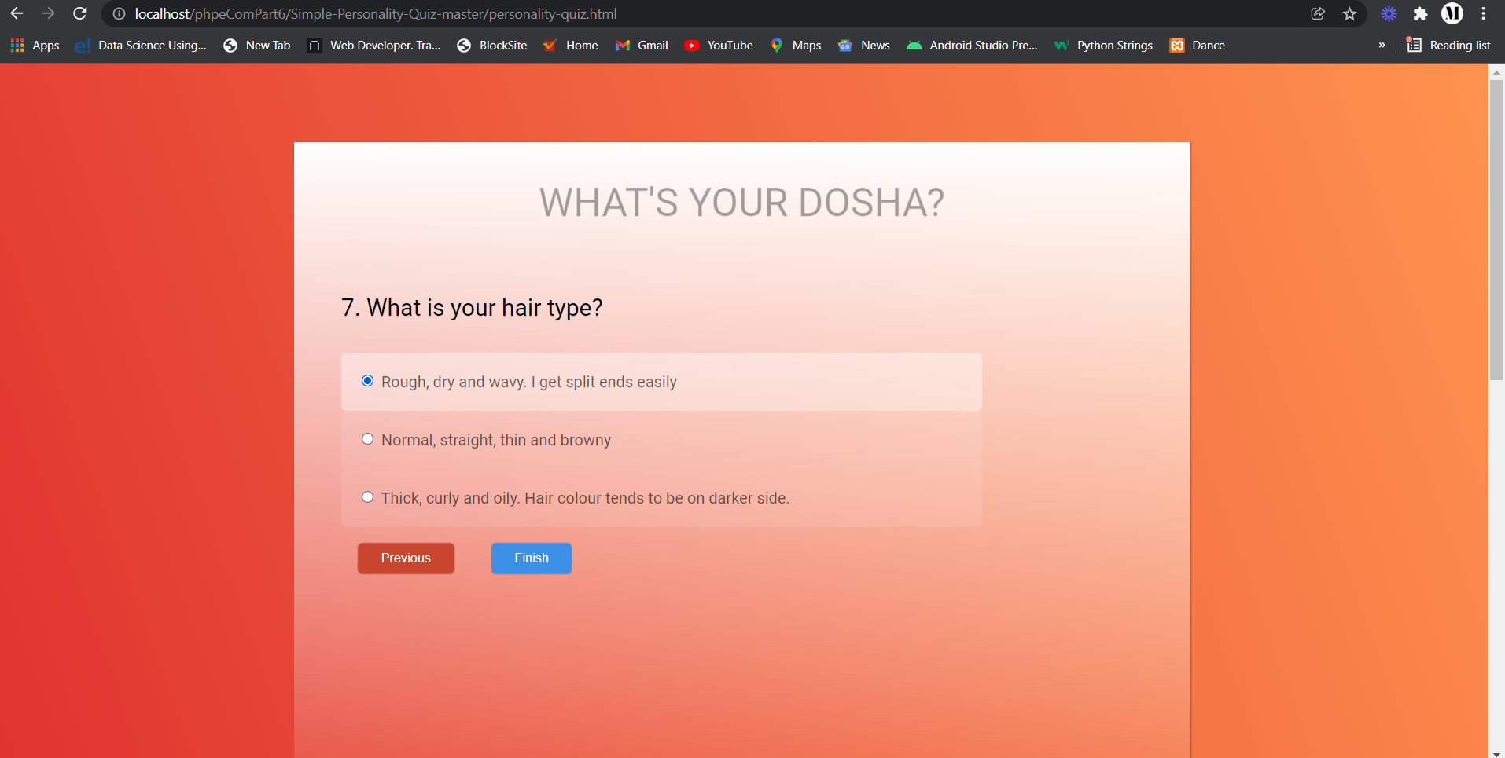
Tridosha Quiz

Slide 24
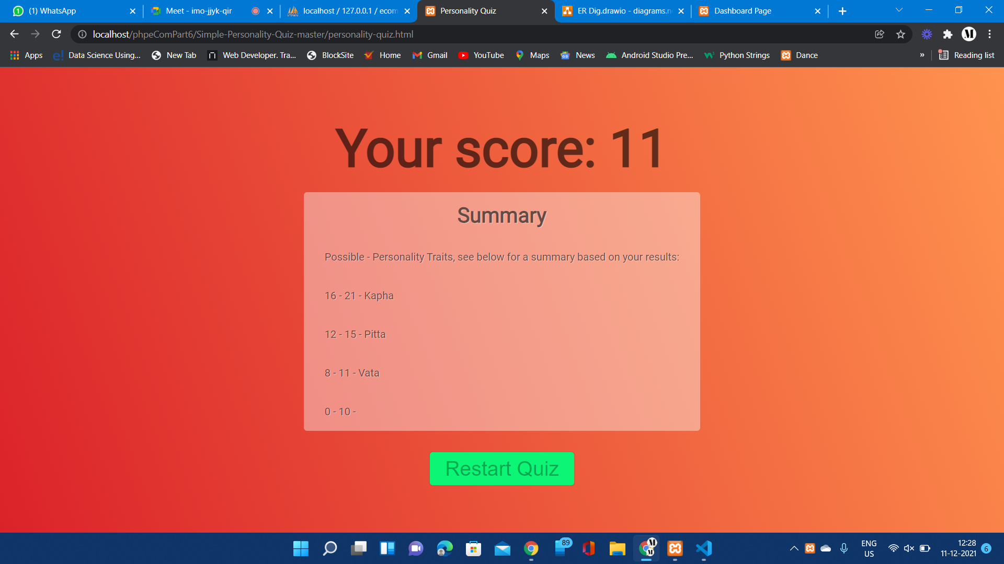
Tridosha Quiz Result Page

Slide 25
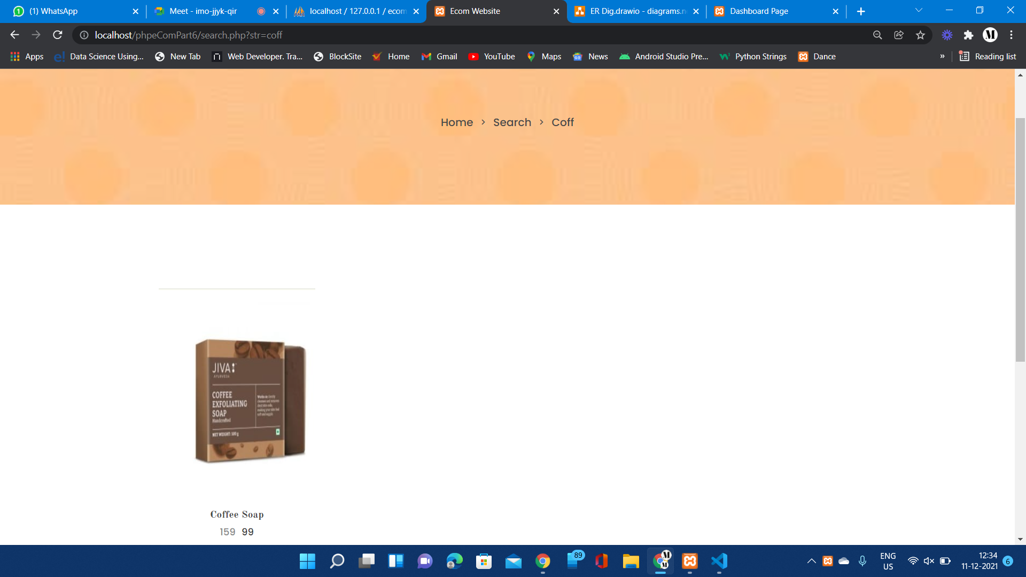
Search

Slide 26

Admin Panel

Slide 27
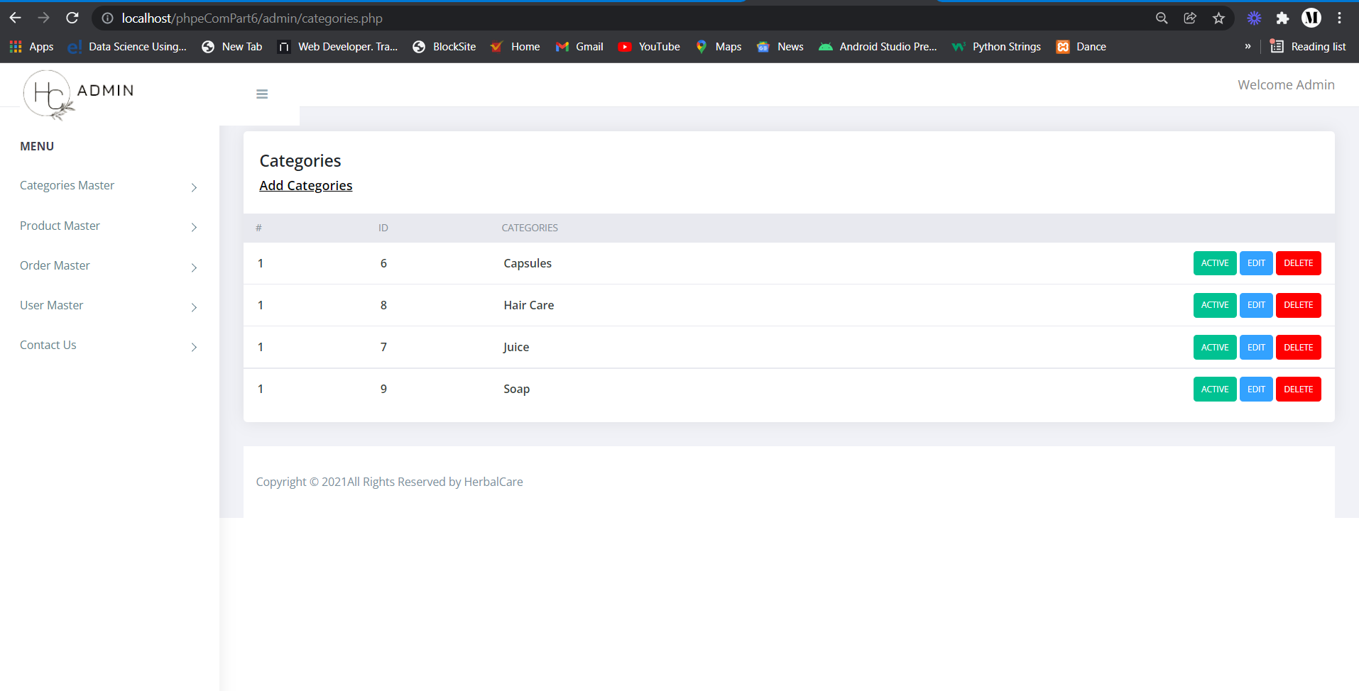
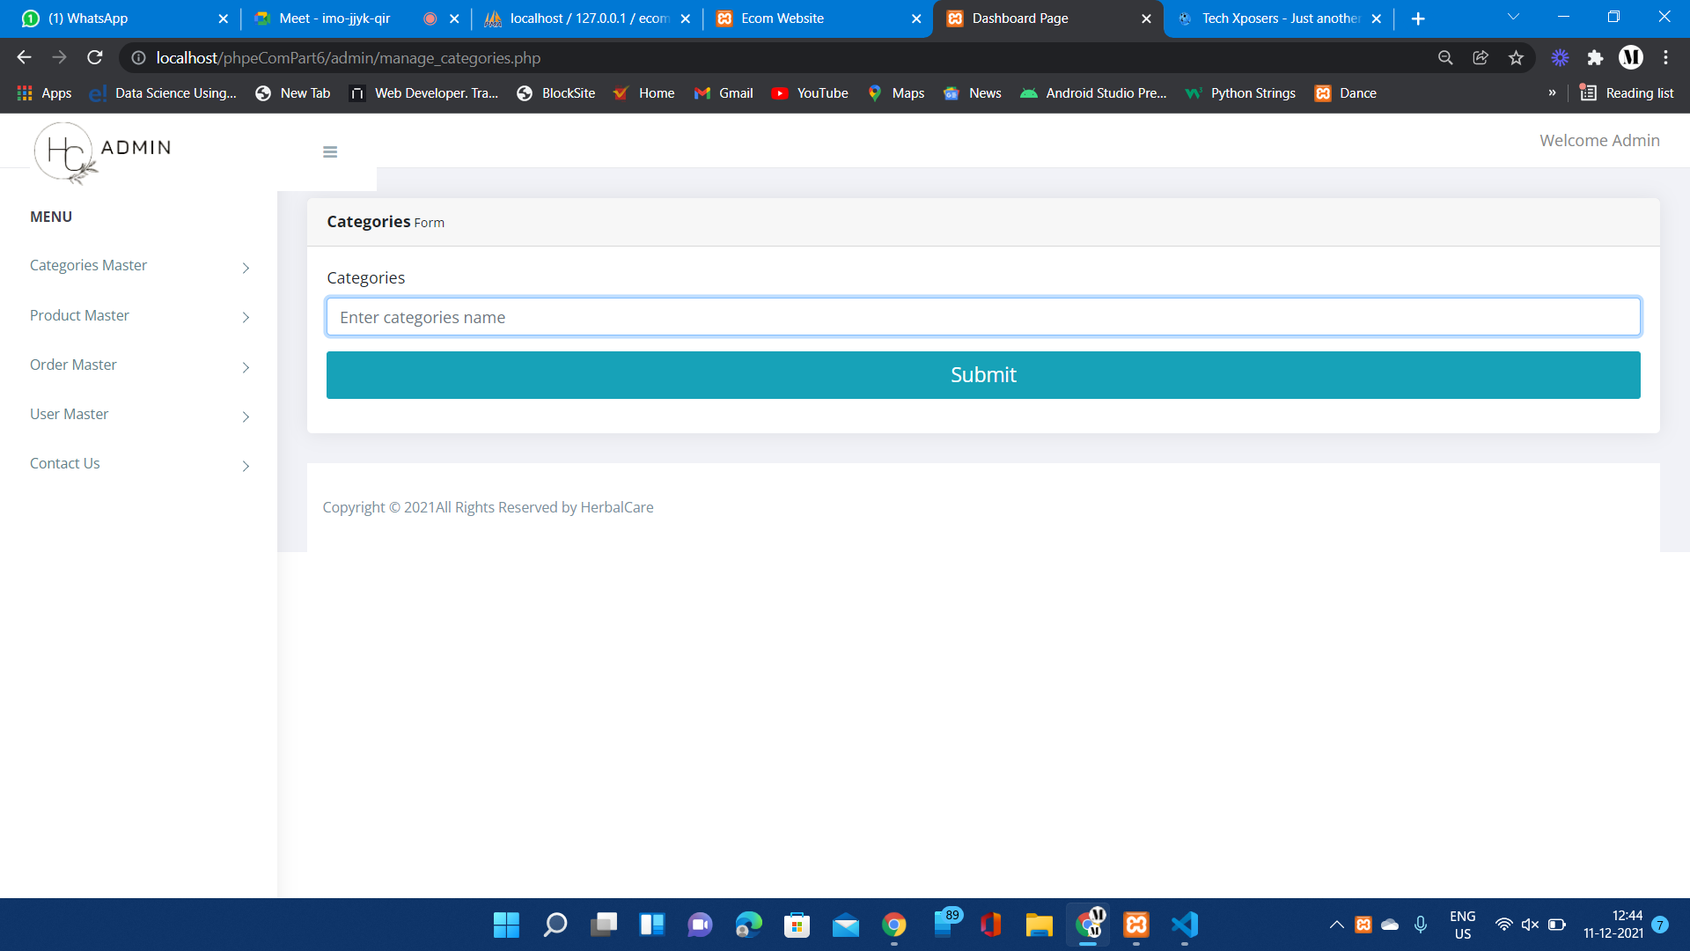
Categories Section

Slide 28
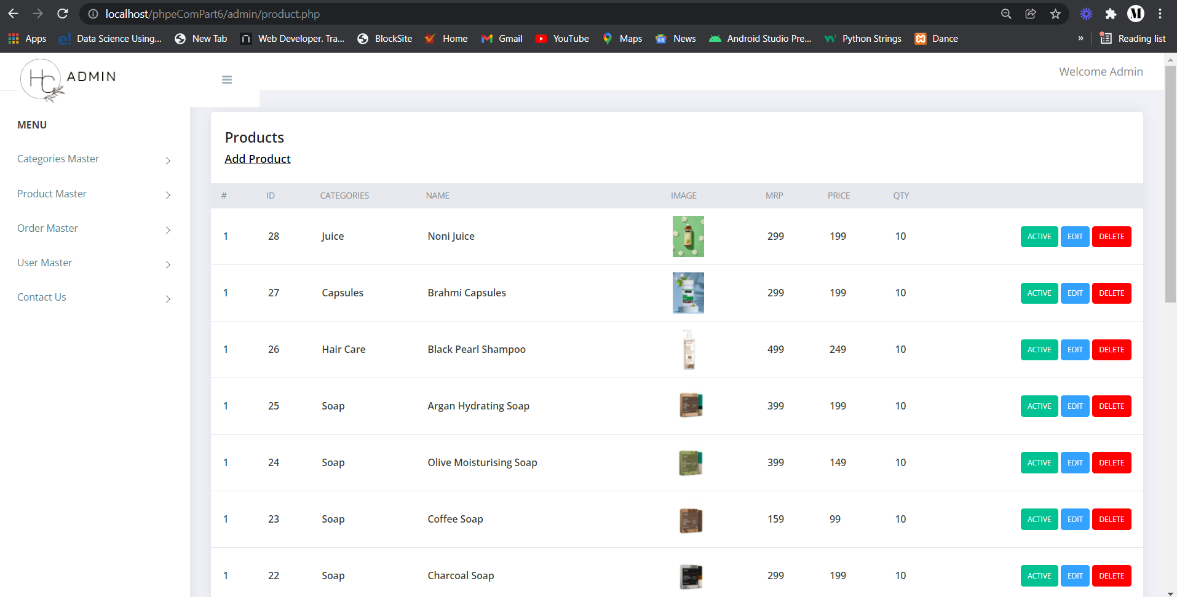
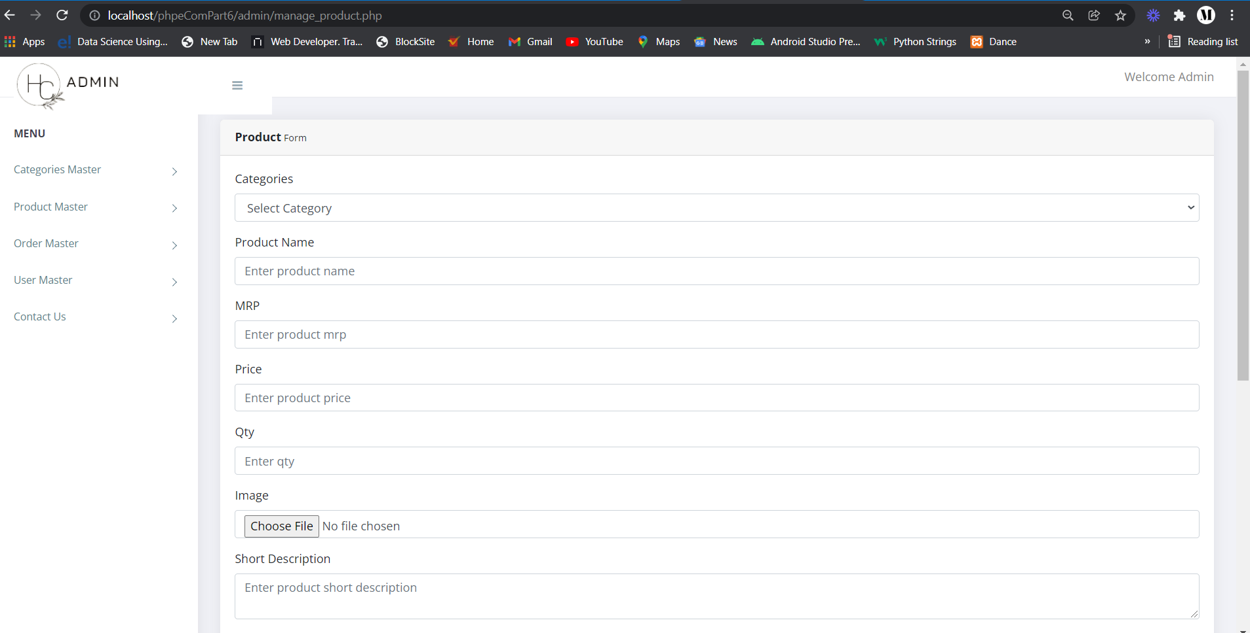
Product Section

Slide 29
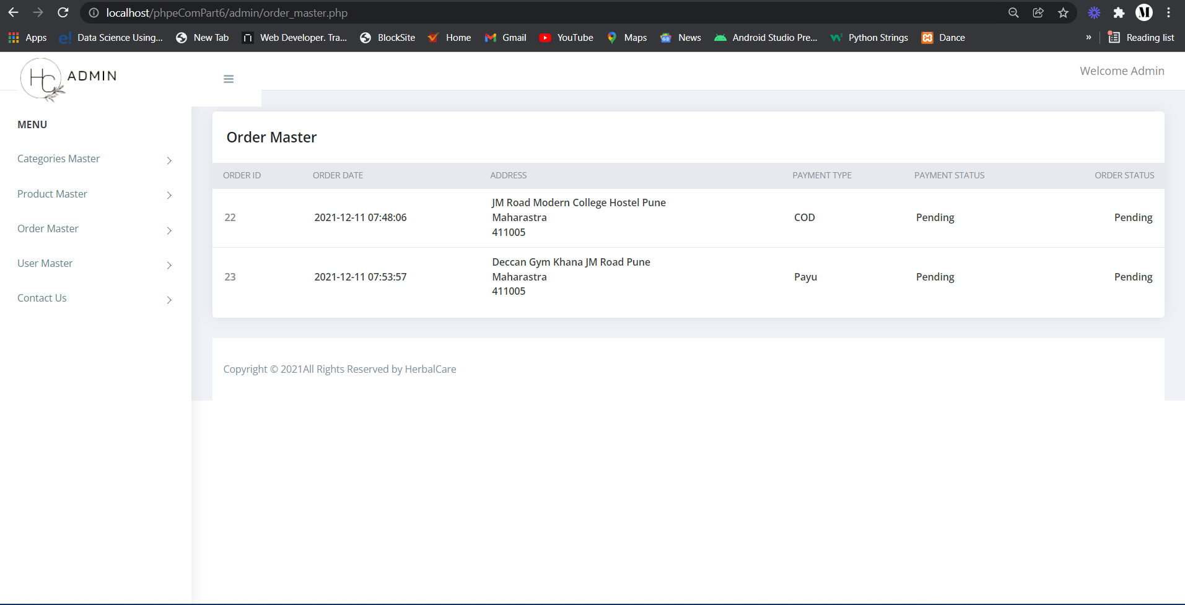
Order Master Section

Slide 30
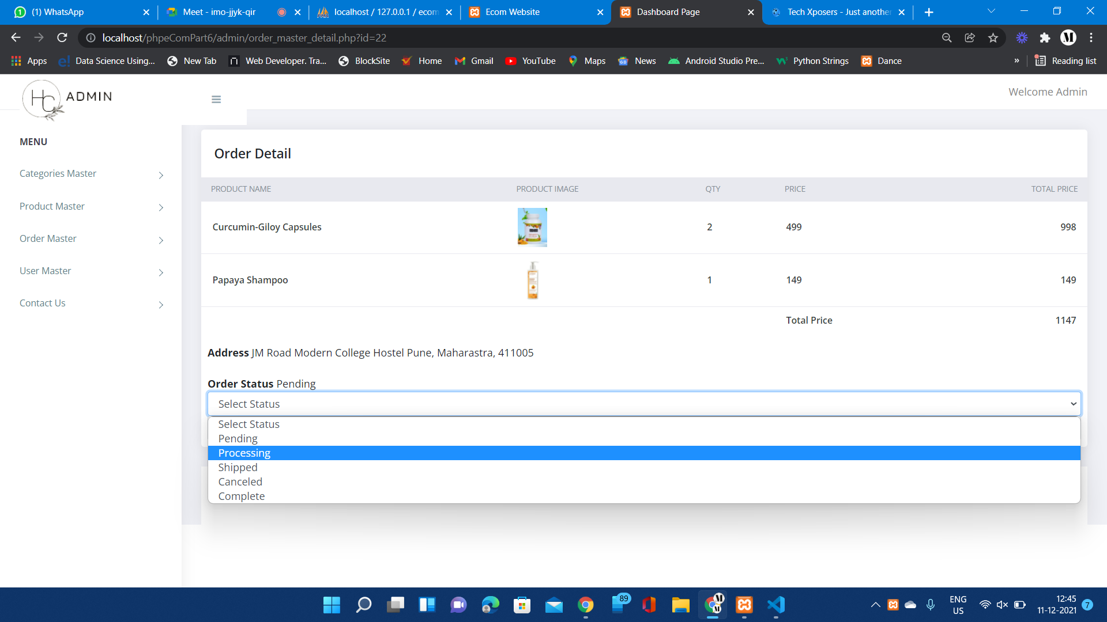
Order Detail Section

Slide 31
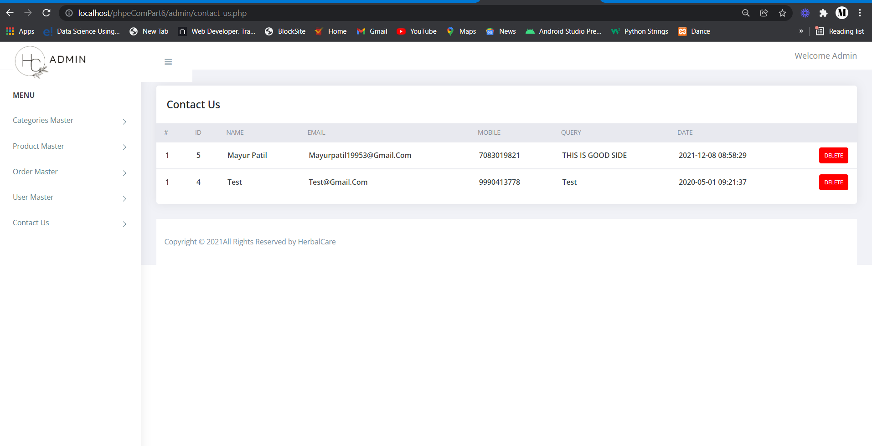
Contact Us Section

Slide 32
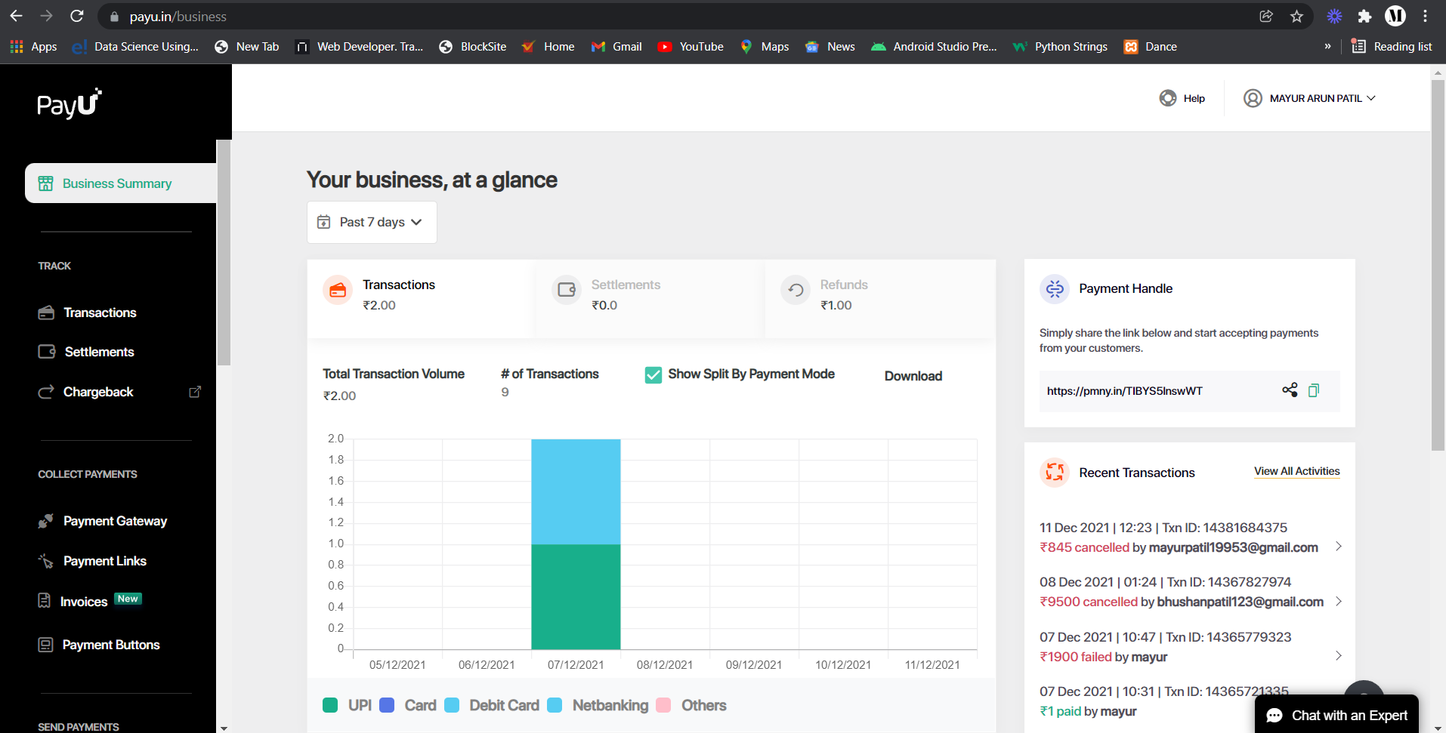
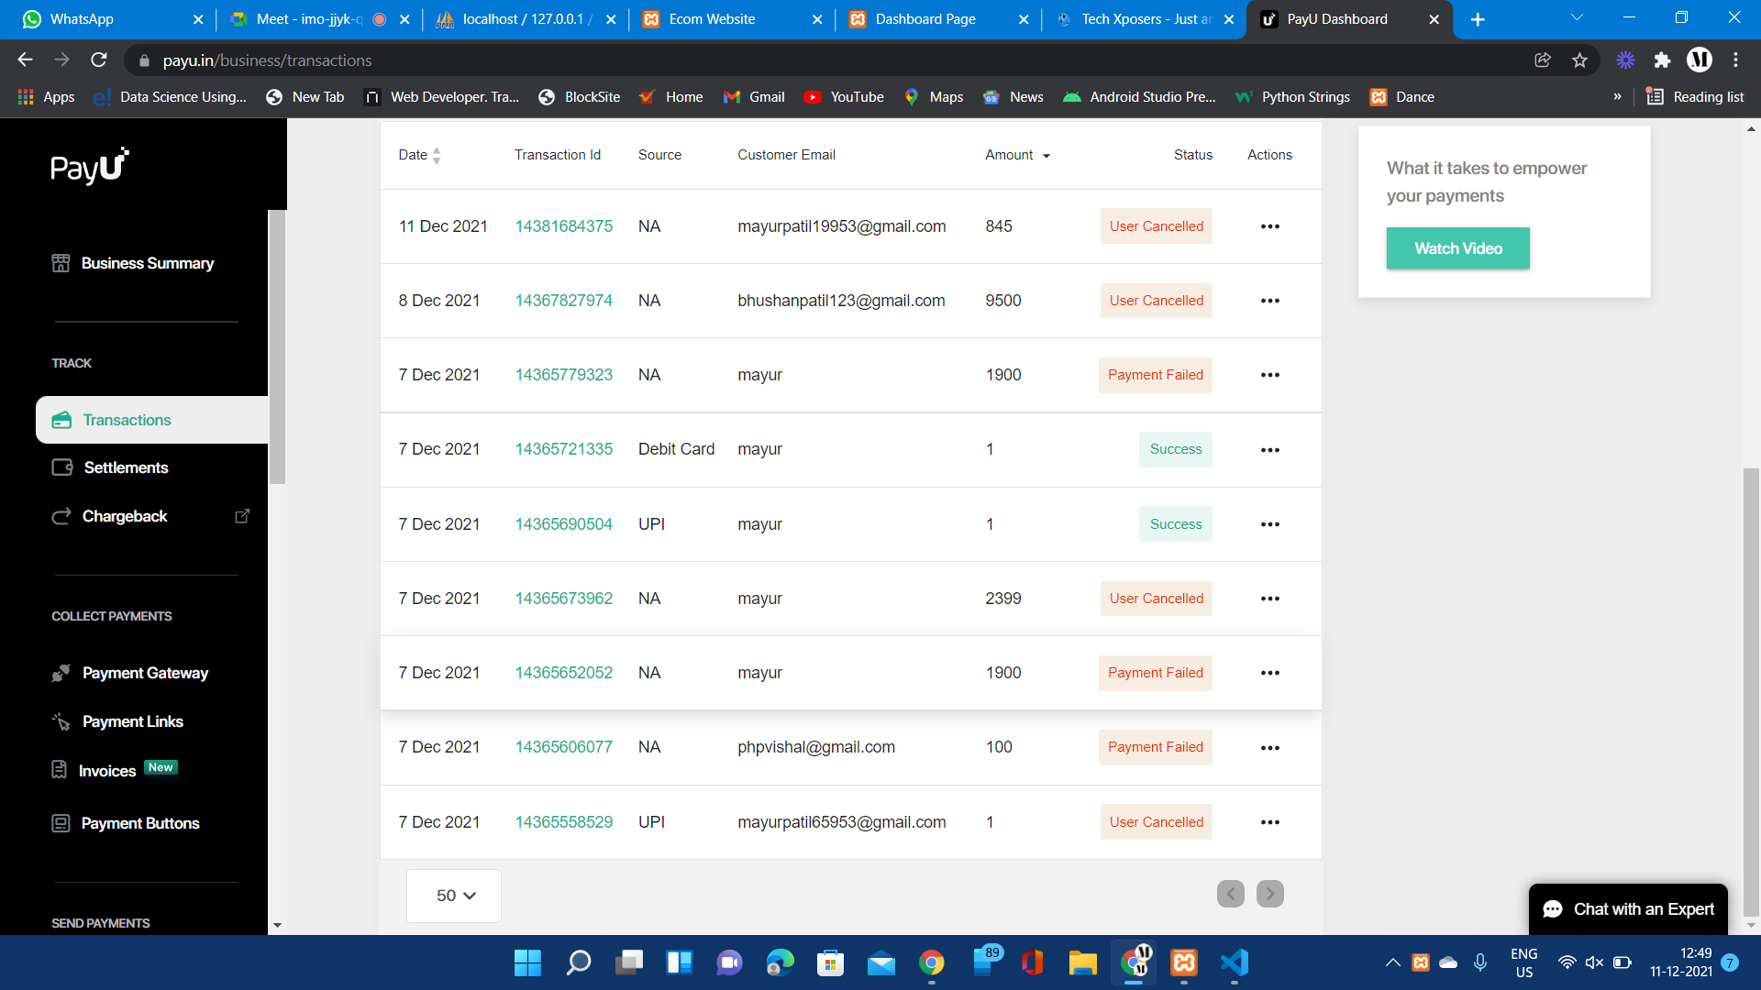
Payment Gateway
Payment Transaction

Slide 33
Thank You

